Slide 1




STARTUPS FUNDING ANALYSIS
by Shama Bansal

Slide 2
PROJECT INTRODUCTION
This project delves into an extensive analysis of global startup funding trends, examining various sectors, funding rounds, geographical regions, and the impact of economic conditions on fundings flows.
By analyzing historical data across over 100 countries, the project highlights key funding distribution patterns, including trends in early-stage (seed, Series A) and late-stage (Series B, C, etc.) rounds.
This project aims to help investors make informed decisions, startups plan better funding journeys, and stakeholders capitalize on emerging opportunities in the dynamic startup ecosystem.

Slide 3

OBJECTIVES
Distribution Analysis
Correlation Analysis
Strategic Recommendations
Distribution Analysis
Explore the relationship between funding characteristics (e.g., funding rounds, types of funding, and location) and the success of startups.
Investigate the impact of geographical location on funding opportunities.
Propose strategies for startups to optimize their funding journeys based on insights from the analysis.
Provide actionable recommendations for aspiring entrepreneurs and investors.
Analyze the distribution of startup funding across various categories, such as industry sectors, markets, and geographical regions.
Identify sectors with higher investment potential.
Notes:
Whether you’re a startup founder, an investor, or just curious about the world of funding, there’s something here for everyone.
To give you a brief overview:
First, we’ll analyze funding trends across different countries and markets.
Next, we’ll examine how funding rounds impact company status(like operating, acquiring or closed).
Finally, I’ll share some strategic insights and discuss the role of economic conditions in startup success.
The data we’ll explore spans over a decade, covering 116 countries, 760 markets, and includes insights from key funding types like seed, venture, and angel rounds. This analysis will help us understand the factors driving funding decisions and what they mean for startups today.

Slide 4
DATASET OVERVIEW
Your paragraph text
There are 17.24% startups that are either relying on their personal fundings or have closed down due to not getting fundings While 88.76% got fundings for their operations in the dataset
FUNDING VS NON FUNDING
The USA has the highest representation in the dataset, almost 58%+, reflecting a strong bias toward American companies. This bias may impact any geographical insights, as trends might not be representative globally.
COUNTRY SKEWNESS
148 funding years data is there but mostly focused period is 2000-2015 as before that startup fundings were very limited
STARTUPS FUNDING TIME

Slide 5
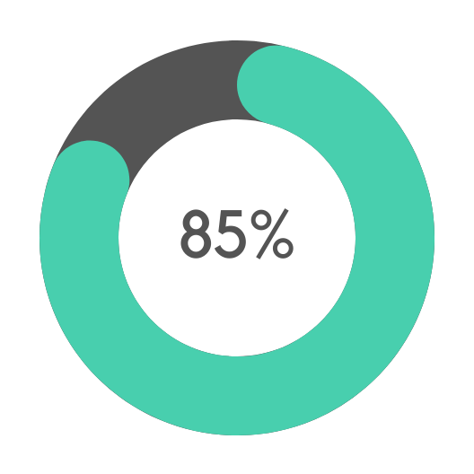
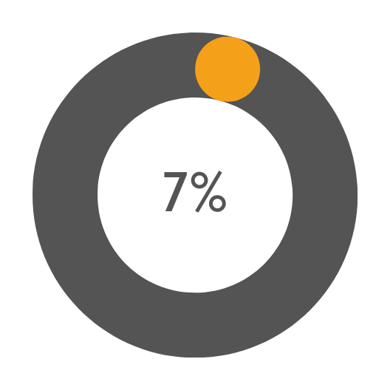
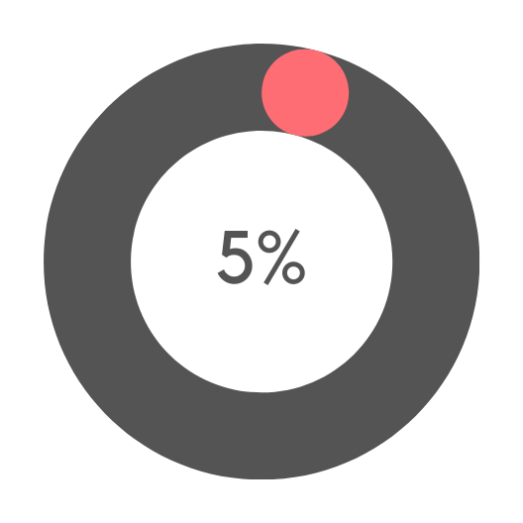
STARTUPS STATUS EVALUATION
OPERATING
ACQUIRED
CLOSED

Slide 6
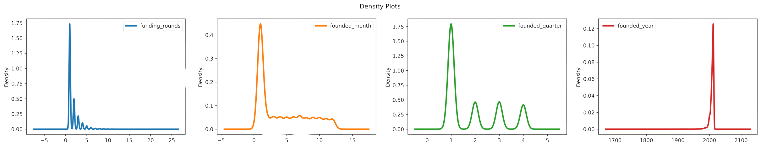
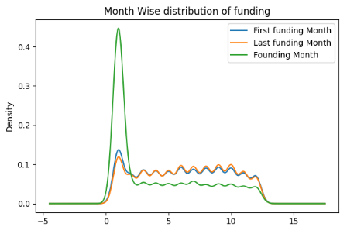
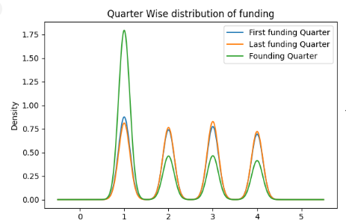
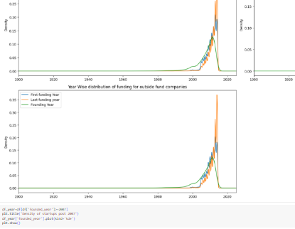
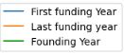
PROJECT TIMELINE
Funding Rounds
Funding Months
Funding Quarters
Funding Years
There’s a steep drop-off after the first round as 65% startups only went throiugh one round and 18% through two round and this trend continues with more rounds. Only 4% goes for four rounds, and it continues to decrease rapidly. This suggests that most startups either struggle to secure additional funding or meet milestones that would justify further investment.
Mostly startups f0unded in January, almost 50% revealing that many startups tend to commence operations at the beginning of the year, possibly to align with new budgets and planningcycles. The counts for July ( and March are relatively high, indicating a continued interest in starting new ventures mid-year.But, steady decline is noted in the later months, with December showing the least number of founded startups..
Q1 consistently shows the highest counts across all startup metrics, indicating a strong trend for funding and founding in the early part of the year while the counts sharply decline in subsequent quarters, particularly in Q4,.The peak for funding occurs in Q3, particularly for final funding rounds, suggesting that many startups are actively closing deals and securing funds by mid-year.
The peak years for first funding are 2013 and 2014. Startups founded around these years appear to have attracted the most funding. These years also see high values for last funding, suggesting an intense funding cycle, with significant follow-up investment occurring soon after initial funding.The rise in startups during 2008-2014 likely correlates with the tech boom
OCT
JAN
MAR
MAY
Funding rounds distribution
Year wise distribution of funding
Launch
FEB

Slide 7
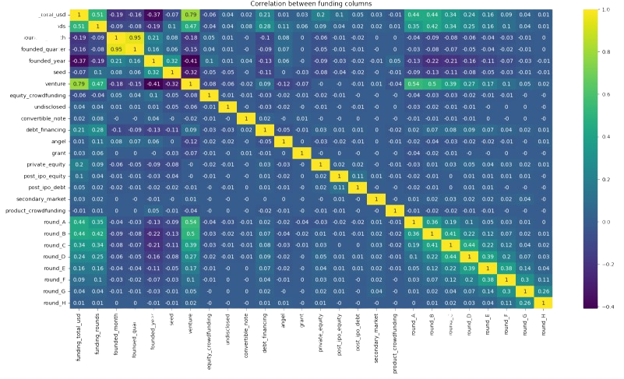
Funding Total (USD) high correlation with Venture Funding suggests that a significant portion of total funding likely comes from venture funding rounds.Its correlation with later Rounds (A, B, C etc) indicates that companies with higher total funding have more advanced funding rounds.
Funding Rounds positive correlation with funding total aligns with the expected pattern where companies with more funding rounds generally accumulate higher funding amounts.
Moderate correlations of funding rounds with Rounds A, B, and C shows that these are common in many funding journeys.
Negative correlation between Founded Year and Total Funding indicates older companies tend to have higher funding totals than recently founded ones, likely due to more time to accumulate fundings.
Seed funding and founded year have moderate correlation which imply that many recently founded startups start with seed funding.
It is negatively correlates with Venture, indicating that companies moving beyond early stages depend less on seed funding as they scale to venture and later rounds.
This analysis reflects the progression of startups from early to advanced stages in their funding cycles, with more established companies generally attracting higher funding through later-stage rounds and venture capital.
:
CORRELATION ANALYSIS

Slide 8
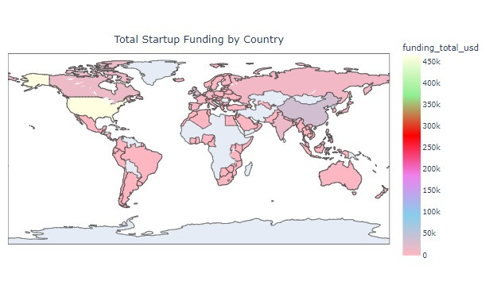

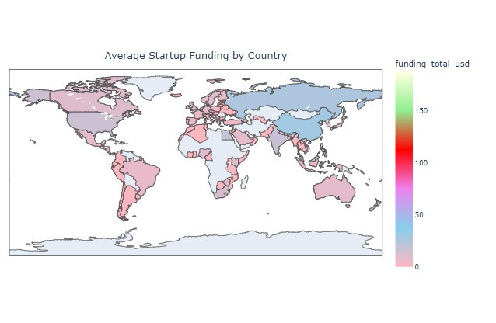
Top Countries by total funding amount
“The USA overwhelmingly leads in total funding, with over 464,000 M total funding, significantly more than any other country. This dominance reflects the high volume of startups and deals, even if individual average amounts are slightly lower.
China (CHN) follows with a significant amount of funding but still far behind the USA. This is consistent with China’s major presence in the global startup ecosystem.
Countries like **India (IND), the UK (GBR), and Canada (CAN) are also notable, indicating they have robust startup environments with substantial total investments.
Smaller countries like Russia (RUS) and Luxembourg (LUX) have high average funding but lower total funding, suggesting fewer deals that tend to be large, rather than a widespread funding landscape.
COUNTRY WISE FUNDING ANALYSIS
Top Countries by average funding amount
Smaller or niche markets appear to lead in average funding amounts. Bermuda (BMU) has the highest average funding amount at around 187.92 M, which is notably higher than other countries.
Other top countries with relatively high average funding amounts include Saint Martin (MAF), China (CHN), Luxembourg (LUX), and Russia (RUS), indicating strong investments per deal but likely fewer total deals compared to larger countries.
Notably, the USA and India, despite large numbers of funded startups, fall somewhat lower in the list in terms of average funding per deal.

Slide 9
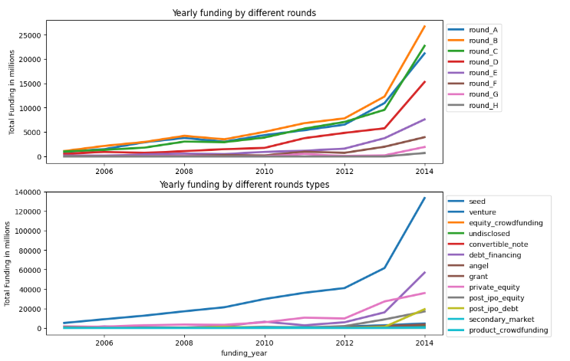

FUNDING ROUNDS AMOUNT BY YEARS
Early-Stage Growth (Rounds A & B): There’s significant growth in funding for early-stage rounds, especially between 2013-2014, which reflects increased risk tolerance by investors as well as more startups entering the ecosystem.
Late-Stage Rounds (F, G, H): Late-stage rounds show that more startups are achieving scale, needing continued rounds of funding, which became evident by the large sums in the 2013-2014 period.
Venture funding saw the largest growth by far, more than doubling between 2012 and 2014, indicating venture capital’s leading role in the startup ecosystem.
Equity crowdfunding and debt financing started playing a role in later years, showing new models of startup financing emerging as alternatives to traditional VC rounds.
The steady rise in funding across rounds and types shows how the startup ecosystem matured, with more startups entering later-stage rounds by 2014.
The shift towards more substantial funding in later rounds and diversification in funding types (like debt financing) reflects both investor confidence in established startups and the need for continued growth capital.
The impact of global economic conditions, such as the 2008 financial crisis, led to strong recovery post-crisis, allowing startups to raise larger rounds and secure a broader array of funding options.

Slide 10

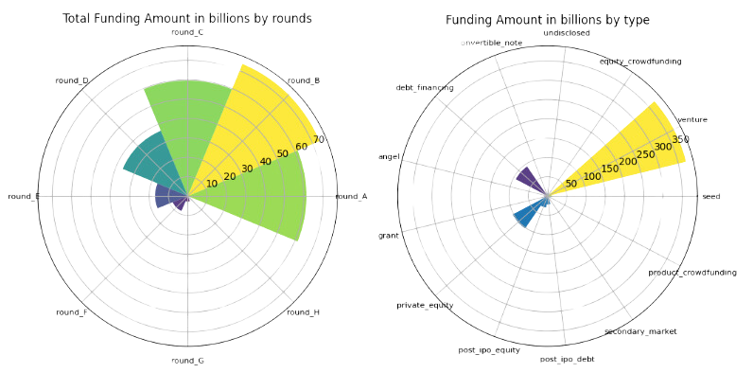
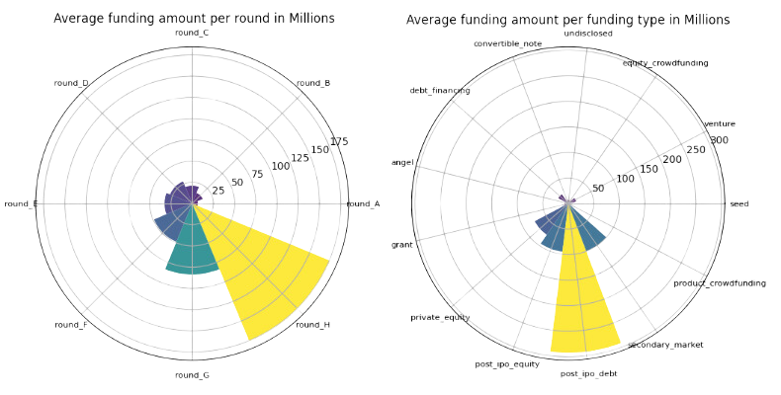
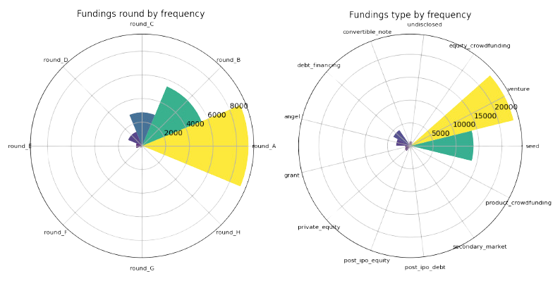
FUNDING ROUNDS AND TYPES ANALYSIS
Early-stage rounds, like A & B, are the most frequent, reflecting a large number of co’s seeking initial growth funding.As rounds progress, the frequency decreases significantly, with round H having only 4 occurrences, indicating the rarity of advanced funding rounds as companies either stabilize or are acquired earlier.
The funding amount across shows a concentration in A, B, and C, with Round B totaling the highest which suggests that mid-stage companies often receive higher investments..
Funding amounts taper off in later rounds, with round H contributing a minimal total of 703.6 M, likely due to fewer co’s reaching these rounds or companies being acquired or self-sustaining by then.
The average funding size increases with each round, reflecting investors’ growing commitment to companies as they progress.Round A starts with an average of 6.83 M, while Round H has an average funding of 175.9 M, indicating significant investment in companies that make it to later stages, signaling their higher valuation and success likelihood.

Slide 11
FUNDING ROUNDS AND TYPES ANALYSIS
Seed and venture funding dominate, with 13,840 and 23,277 deals resp, as these are primary funding types for both early and mid-stage companies.
Less common types, like secondary market (19 deals) and post-IPO debt (75 deals), cater to mature companies with specific needs (e.g., liquidity for existing shareholders or restructuring debt).
Venture funding takes a significant lead with 370,837 M total funding, showing it as the most substantial investment type, especially for companies in growth phases.
Debt financing and private equity follow at 93,347 M and 102,549 M, typically seen in established companies requiring structured capital solutions.
Smaller amounts go to crowdfunding types (equity, product crowdfunding), which often involve smaller investors and are typically used for niche or early-stage financing.
Post-IPO Debt has the highest average at 292.3 M. This large size is typical of later-stage or public companies seeking large financing amounts for restructuring.
Venture has an average deal size of 15.93 M, indicating robust funding but distributed across a large number of companies.
Private equity (74.69 M) & secondary market (100.06 M) show higher average deal sizes as they target companies with established valuations, often as part of strategic growth or exit plans.

Slide 12
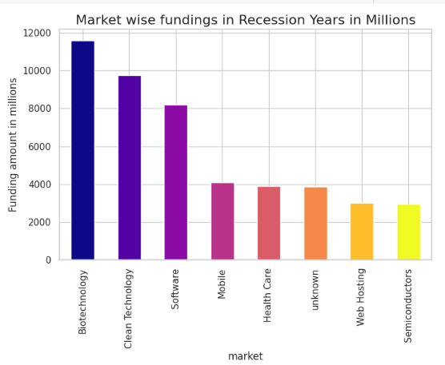
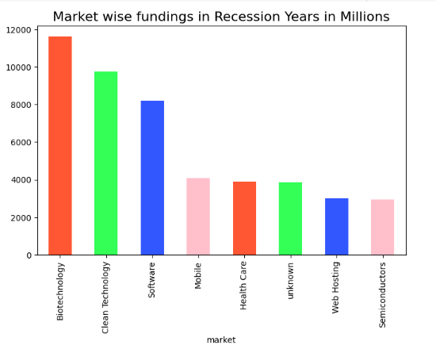
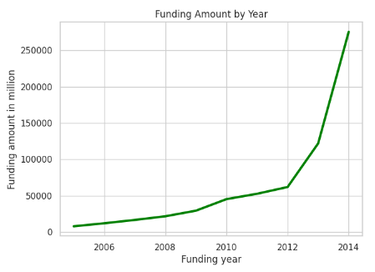
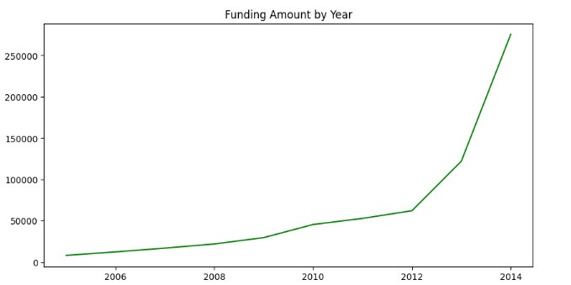
FUNDING ANALYSIS IN 2008-2010
+24K
GREAT RECESSION
2008
Despite the global economic downturn in 2008, there was a notable jump in funding, rising from $16.75 billion in 2007 to $21.77 billion in 2008. This could indicate that investors continued to fund startups, particularly in tech, which was more resilient than other sectors during the crisis.
POST RECESSION
2009
However, 2009 may show the lagging effects of the crisis, where growth slowed somewhat compared to previous years. Though there is healthy growth in the startup ecosystem, likely driven by innovation in tech and increasing investor interest.
RECOVERY PERIOD
2010
Starting from 2010, there is a significant uptick in funding, with the total climbing from $45.34 billion in 2010 to $527.72 billion in 2014. This post-recession boom coincides with global economic recovery, as well as the rise of major tech unicorns, increased venture capital activity, and growing investor confidence in startups.
The fundings in 2008-2010 has been mainly due to sectors like Biotech, Clean Technology, Software, Mobile, health etc.These sectors remained resilient, showing that these sectors attracted more funding despite broader economic uncertaintie

Slide 13
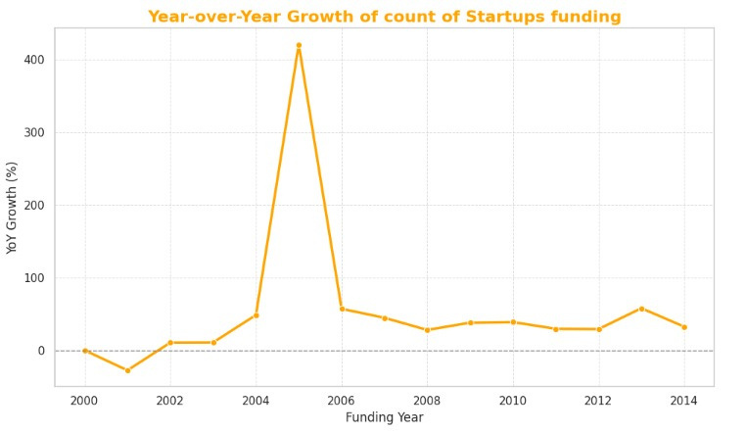
YOY GROWTH TREND
There was an explosive increase in YoY growth during 2005-2007, driven by an influx of capital into emerging startups, with 2005 being the standout year with over 420% growth.
Despite the financial crisis in 2008, the startup ecosystem continued to grow, reflecting the strength of tech and innovation as key areas of investment.
Post-crisis(2009-2014) he market rebounded quickly, with continuous double-digit growth, peaking again in 2013 with 57.78% YoY growth, possibly due to the maturing of the tech ecosystem and the rise of unicorn startups. Signs of Maturity: The slightly slower growth rates in 2014 (32.39%) suggest that the market might have been entering a more mature phase, with fewer opportunities for massive YoY jumps.
Overall, the data shows a clear trajectory of rapid expansion, particularly in the mid-2000s, followed by more stable, though still substantial, growth in the years leading up to 2014. This reflects the evolution of the startup funding landscape from early-stage, high-risk investments to a more established ecosystem.

Slide 14
RECOMMENDATIONS REPORT
FOR INVESTORS
FOR STARTUPS
Invest in High growth sectors while exploring Clean technology.
Geographical diversification
Watch niche markets
Encourage collaborative Innovations
focus on recession free sectors
Target Specialized Markets
Build Strategic alliances
Prepare for regional competitiveness
Emphasize Scalability
Seeking fund in emerging markets
Strengthen early stage funding proposals

Slide 15
THANK YOU
presented by
SHAMA BANSAL

